Slide 1
Chapter 7: IP Addressing
Instructor Materials
CCNA Routing and Switching
Introduction to Networks v6.0
Notes:
Cisco Networking Academy Program
Introduction to Networks v6.0
Chapter 7: IP Addressing

Slide 2
Instructor Materials – Chapter 7 Planning Guide
This PowerPoint deck is divided in two parts:
Instructor Planning Guide
Information to help you become familiar with the chapter
Teaching aids
Instructor Class Presentation
Optional slides that you can use in the classroom
Begins on slide # 16
Note: Remove the Planning Guide from this presentation before sharing with anyone.
Notes:
2

Slide 3
Chapter 7: IP Addressing
Introduction to Networks 6.0 Planning Guide
Notes:
Cisco Networking Academy Program
Introduction to Networks v6.0
Chapter 7: IP Addressing

Slide 4
Chapter 7: Activities
What activities are associated with this chapter?
Page # | Activity Type | Activity Name | Optional?
7.0.1.2 | Class Activity | Modeling the Internet of Everything (IoE) | Optional
7.1.1.2 | Video | Decimal to Binary Conversions | Recommended
7.1.1.4 | Interactive Activity | Binary to Decimal Conversions | Recommended
7.1.1.8 | Interactive Activity | Decimal to Binary Conversions | Recommended
7.1.1.9 | Interactive Activity | Binary Game | Optional
7.1.2.4 | Interactive Activity | ANDing to Determine the Network Address | Recommended
7.1.2.7 | Video Demonstration | Network, Host, and Broadcast Addresses | Recommended
7.1.2.8 | Lab | Using the Windows Calculator with Network Addresses | Optional
7.1.2.9 | Lab | Converting IPv4 Addresses to Binary | Recommended
7.1.3.7 | Interactive Activity | Unicast, Broadcast, or Multicast | Recommended
7.1.3.8 | Packet Tracer | Investigate Unicast, Broadcast, and Multicast Traffic | Optional
The password used in the Packet Tracer activities in this chapter is: PT_ccna5
Notes:
4

Slide 5
Chapter 7: Activities (Cont.)
What activities are associated with this chapter?
Page # | Activity Type | Activity Name | Optional?
7.1.4.2 | Interactive Activity | Pass or Block IPv4 Addresses | Recommended
7.1.4.5 | Video Demonstration | Classful IP Addressing | Recommended
7.1.4.8 | Interactive Activity | Public or Private IPv4 Addresses | Recommended
7.1.4.9 | Lab | Identifying IPv4 Addresses | Optional
7.2.1.3 | Interactive Activity | IPv4 Issues and Solutions | Recommended
7.2.2.4 | Interactive Activity | Practicing IPv6 Address Representations | Recommended
7.2.3.5 | Interactive Activity | Identify Types of IPv6 Address | Recommended
7.2.4.2 | Syntax Checker | Configuring IPv6 on a Router | Recommended
7.2.4.8 | Syntax Checker | Verifying IPv6 Address Configuration | Recommended
7.2.4.9 | Packet Tracer | Configuring IPv6 Addressing | Recommended
7.2.5.3 | Lab | Identifying IPv6 Addresses | Optional
The password used in the Packet Tracer activities in this chapter is: PT_ccna5
Notes:
5

Slide 6
Chapter 7: Activities (Cont.)
What activities are associated with this chapter?
Page # | Activity Type | Activity Name | Optional?
7.2.5.4 | Lab | Configuring IPv6 Addresses on Network Devices | Recommended
7.3.2.5 | Packet Tracer | Verifying IPv4 and IPv6 Addressing | Optional
7.3.2.6 | Packet Tracer | Pinging and Tracing to Test the Path | Optional
7.3.2.7 | Lab | Testing Network Connectivity with Ping and Traceroute | Optional
7.3.2.8 | Lab | Mapping the Internet | Recommended
7.3.2.9 | Packet Tracer | Troubleshooting IPv4 and IPv6 Addressing | Recommended
7.4.1.1 | Class Activity | The Internet of Everything…Naturally! | Optional
7.4.1.2 | Packet Tracer | Skills Integration Challenge | Recommended
The password used in the Packet Tracer activities in this chapter is: PT_ccna5
Notes:
6

Slide 7
Chapter 7: Assessment
Students should complete Chapter 7, “Assessment” after completing Chapter 7.
Quizzes, labs, Packet Tracers and other activities can be used to informally assess student progress.
Notes:
7

Slide 8
Chapter 7: Best Practices
Prior to teaching Chapter 7, the instructor should:
Complete Chapter 7, “Assessment.”
The objectives of this chapter are:
Convert between binary and decimal numbering systems.
Describe the structure of an IPv4 address including the network portion, the host portion, and the subnet mask.
Compare the characteristics and uses of the unicast, broadcast and multicast IPv4 addresses.
Explain public, private, and reserved IPv4 addresses.
Explain the need for IPv6 addressing.
Describe the representation of an IPv6 address.
Compare types of IPv6 network addresses.
Configure global unicast addresses.
Describe multicast addresses.
Explain how ICMP is used to test network connectivity.
Use ping and traceroute utilities to test network connectivity.
Notes:
8

Slide 9
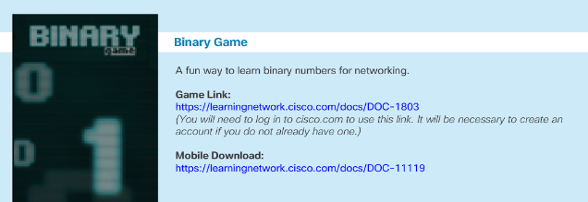
Chapter 7: Best Practices (Cont.)
Section 7.1
Remind students of the positional notation-place value in decimal to help explain binary place values (see video 7.1.1.7).
Have students create their own place values chart for binary.
Encourage students to practice conversions until they are comfortable with the process without using calculators. By doing the conversions manually, students will learn how bits can be manipulated to produce the binary equivalent of a decimal value. No calculators are permitted during CCNA certification exams.
Direct the students to the binary game to test their binary-decimal conversion skills.
Notes:
9

Slide 10
Chapter 7: Best Practices (Cont.)
Section 7.1 (Cont.)
Explain the hierarchical structure of an IP address by using analogies like mailing address and phone numbers.
Demonstrate the ANDing process.
Recommend activity 7.1.2.4 and video 7.1.2.7.
Practice conversion – lab 7.1.2.9
Students must know the private address blocks.
Recommend they do activity 7.1.4.8.
Discuss the addressing scheme used in their home and at your institution.
Legacy Classful Addressing.
Do not spend much time on this.
It is useful to see the foundation of IPv4 addressing and the reasons for depletion of addresses.
Notes:
10

Slide 11
Chapter 7: Best Practices (Cont.)
Section 7.2
Explain the structure of an IPv6 address.
IPv6 addresses are128 bits and are represented using hexadecimal values.
Four bits can be represented with a single hexadecimal value. Four hex digits = hextet
The prefix length is used to indicate the network portion of an IPv6 address can range from 0 to 128. Typical LAN prefix length /64
Encourage students to use activity 7.2.2.4 to practice compressing IPv6 addresses.
Point out the important features of the IPv6 link-local address
Enables a device to communicate with other IPv6-enabled devices on the same link.
Every IPv6-enabled network interface is required to have a link-local address.
If not configured manually on an interface, it will be automatically created.
Link-local addresses are in the FE80::/10 range.
Notes:
11

Slide 12
Chapter 7: Best Practices (Cont.)
Section 7.2 (Cont.)
Explain the parts of an IPv6 Global Unicast address and compare it to IPv4.
Global routing prefix the network portion of the address that is assigned by the provider, such as an ISP.
The Subnet ID can be used by an organization to identify subnets within its site.
Interface ID is equivalent to the host portion of an IPv4 address.
Students should do interactive activity 7.2.3.5 to reinforce.
Discuss the three Router Advertisement options
SLAAC only - I'm everything you need (Prefix, Prefix-length, Default Gateway)"
SLAAC and DHCPv6 - "Here is my information but you need to get other information such as DNS addresses from a DHCPv6 server.“
DHCPv6 only - "I can’t help you. Ask a DHCPv6 server for all your information."
Notes:
12

Slide 13
Chapter 7: Best Practices (Cont.)
Section 7.3
Use Packet Tracer to demonstrate verifying IPv4 and IPv6 Addressing 7.3.2.5.
Use Packet Tracer to demonstrate using Ping and Traceroute to test connectivity 7.3.2.6.
Notes:
13

Slide 14
Chapter 7: Additional Help
For additional help with teaching strategies, including lesson plans, analogies for difficult concepts, and discussion topics, visit the CCNA Community at: https://www.netacad.com/group/communities/community-home
Best practices from around the world for teaching CCNA Routing and Switching. https://www.netacad.com/group/communities/ccna
If you have lesson plans or resources that you would like to share, upload them to the CCNA Community in order to help other instructors.
Students can enroll in Introduction to Packet Tracer (self-paced).
Notes:
14

Slide 16
Chapter 7: IP Addressing
CCNA Routing and Switching
Introduction to Networks v6.0
Notes:
Cisco Networking Academy Program
Introduction to Networks v6.0
Chapter 7: IP Addressing

Slide 17
Chapter 7 - Sections & Objectives
7.1 IPv4 Network Addresses
Explain the use of IPv4 addresses to provide connectivity in small to medium-sized business networks
Convert between binary and decimal numbering systems.
Describe the structure of an IPv4 address including the network portion, the host portion, and the subnet mask.
Compare the characteristics and uses of the unicast, broadcast and multicast IPv4 addresses.
Explain public, private, and reserved IPv4 addresses.
7.2 IPv6 Network Addresses
Configure IPv6 addresses to provide connectivity in small to medium-sized business networks.
Explain the need for IPv6 addressing.
Describe the representation of an IPv6 address.
Compare types of IPv6 network addresses.
Configure global unicast addresses.
Describe multicast addresses.
Notes:
17
Cisco Networking Academy Program
Introduction to Networks v6.0
Chapter 7: IP Addressing

Slide 18
Chapter 7 - Sections & Objectives (Cont.)
7.3 Connectivity Verification
Use common testing utilities to verify and test network connectivity.
Explain how ICMP is used to test network connectivity.
Use ping and traceroute utilities to test network connectivity.
Notes:
18
Cisco Networking Academy Program
CCNA Routing and Switching v6.0
Chapter 7: IP Addressing

Slide 19
7.1 IPv4 Network Addresses
Notes:
7 – IP Addressing
7.1 – IPv4 Network Addresses

Slide 20
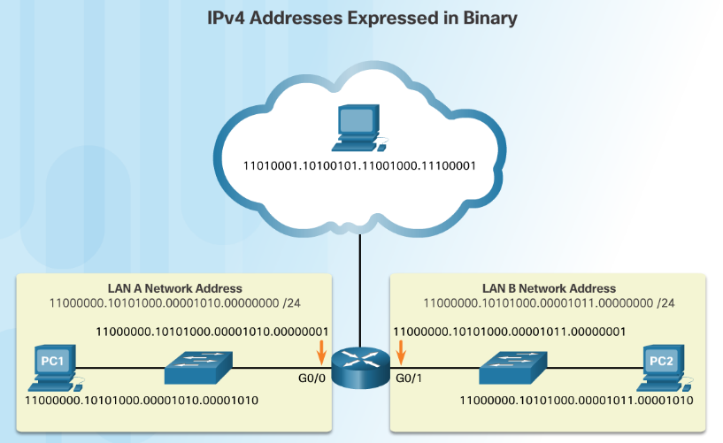
Binary and Decimal Conversion IPv4 Addresses
Binary numbering system consists of the numbers 0 and 1 called bits
IPv4 addresses are expressed in 32 binary bits divided into 4 8-bit octets
Notes:
7.1 – IPv4 Network Addresses
7.1.1 – Binary and Decimal Conversion
7.1.1.1 IPv4 Addresses

Slide 21
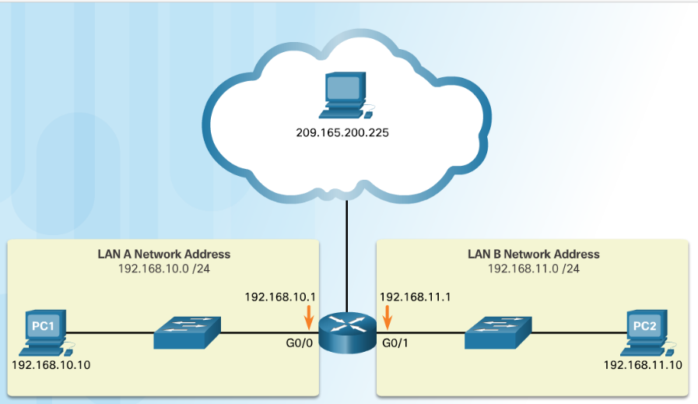
Binary and Decimal Conversion IPv4 Addresses (Cont.)
IPv4 addresses are commonly expressed in dotted decimal notation
Notes:
7.1 – IPv4 Network Addresses
7.1.1 – Binary and Decimal Conversion
7.1.1.1 IPv4 Addresses (Cont.)

Slide 22
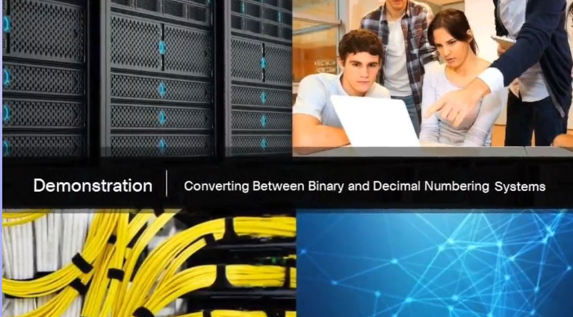
Binary and Decimal Conversation Video Demonstration – Converting Between Binary and Decimal Numbering Systems
This video will cover the process of ANDing as it relates to discovering the network address, the host addresses, and the broadcast address in an IPv4 network.
Notes:
7.1 – IPv4 Network Addresses
7.1.1 – Binary and decimal Conversion
7.1.1.2–Video Demonstration - Converting Between Binary and Decimal Numbering System

Slide 23
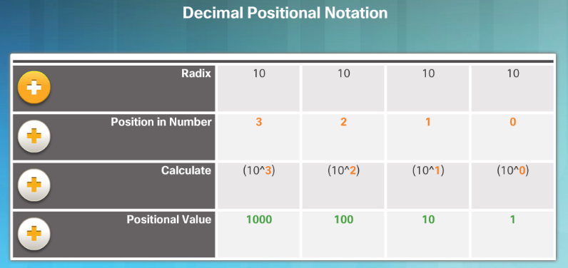
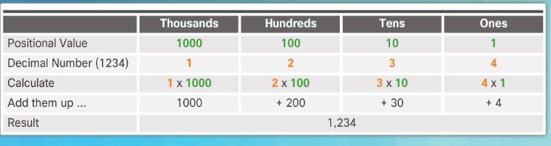
Binary and Decimal Conversion Positional Notation
The first row identifies the number base or radix. Decimal is 10. Binary is based on 2, therefore radix will be 2
The 2nd row considers the position of the number starting with 0. These numbers also represent the exponential value that will be used to calculate the positional value (4th row).
The 3rd row calculates the positional value by taking the radix and raising it by the exponential value of its position. Note: n^0 is always = 1.
The positional value is listed in the fourth row.
Applying decimal positional notation
Notes:
7.1 – IPv4 Network Addresses
7.1.1 – Binary and Decimal Conversion
7.1.1.3 Positional Notation

Slide 24
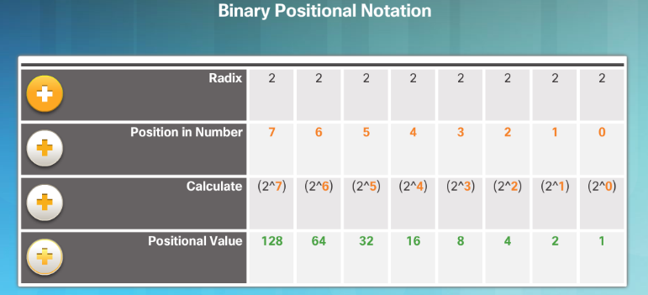
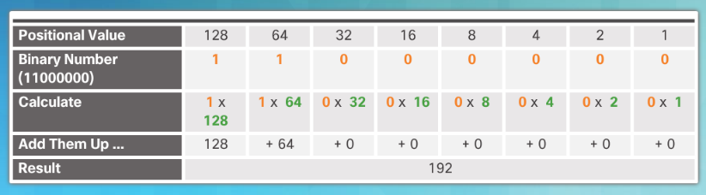
Binary and Decimal Conversion Positional Notation (Cont.)
Applying binary positional notation.
Notes:
7.1 – IPv4 Network Addresses
7.1.1 – Binary and Decimal Conversion
7.1.1.3 Positional Notation (Cont.)

Slide 25
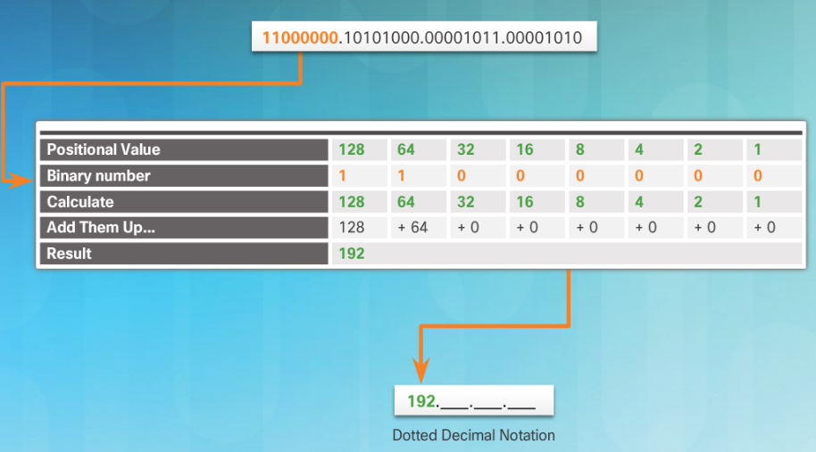
Binary and Decimal Conversion Binary to Decimal Conversion
To convert a binary IPv4 address to decimal enter the 8-bit binary number of each octet under the positional value of row 1 and then calculate to produce the decimal.
Notes:
7.1 – IPv4 Network Addresses
7.1.1 – Binary and Decimal Conversion
7.1.1.4 Binary to Decimal Conversion

Slide 26
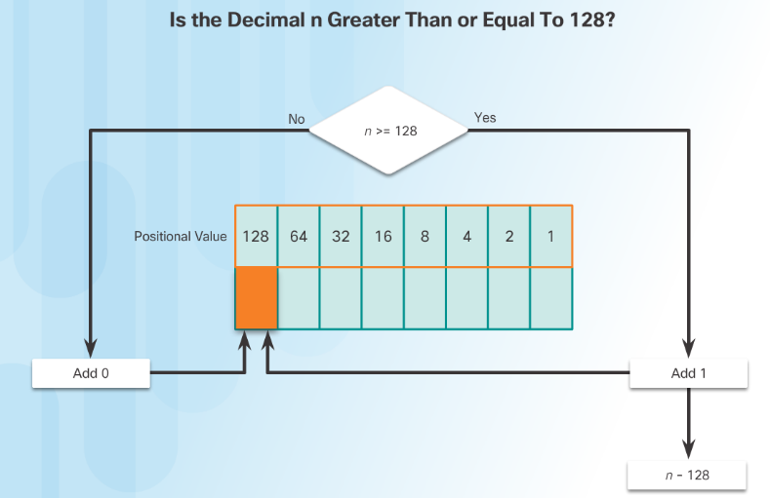
Binary and Decimal Conversion Decimal to Binary Conversion
To convert a decimal IPv4address to binary use the positional chart and check first if the number is greater than the 128 bit. If no a 0 is placed in this position. If yes then a 1 is placed in this position.
128 is subtracted from the original number and the remainder is then checked against the next position (64) If it is less than 64 a 0 is placed in this position. If it is greater, a 1 is placed in this position and 64 is subtracted.
The process repeats until all positional values have been entered.
Notes:
7.1 – IPv4 Network Addresses
7.1.1 – Binary and Decimal Conversion
7.1.1.6 Decimal to Binary Conversion

Slide 27
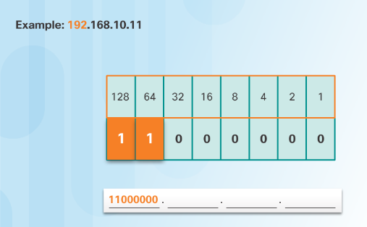
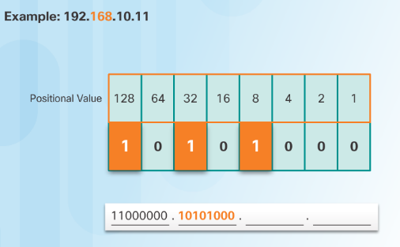
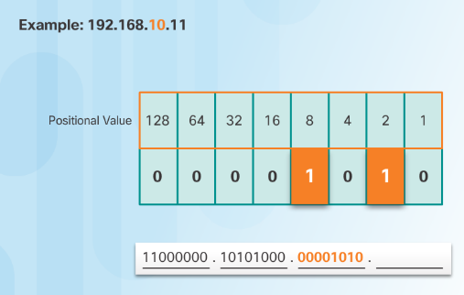
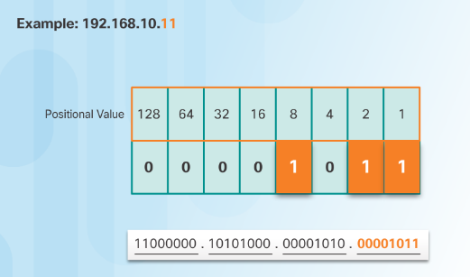
Binary and Decimal Conversion Decimal to Binary Conversion Examples
Notes:
7.1 – IPv4 Network Addresses
7.1.1 – Binary and Decimal Conversion
7.1.1.7 Decimal to Binary Conversion Examples

Slide 28
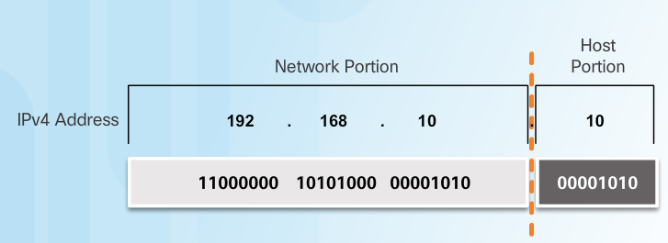
IPv4 Address Structure Network and Host Portions
An IPv4 address is hierarchical.
Composed of a Network portion and Host portion.
All devices on the same network must have the identical network portion.
The Subnet Mask helps devices identify the network portion and host portion.
Notes:
7.1 – IPv4 Network Addresses
7.1.2 – IPv4 Address Structure
7.1.2.1 Network and Host Portions

Slide 29
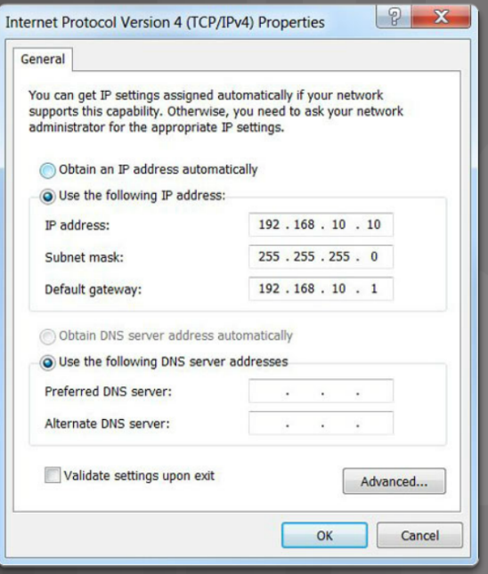
IPv4 Address Structure The Subnet Mask
Three IPv4 addresses must be configured on a host:
Unique IPv4 address of the host.
Subnet mask - identifies the network/host portion of the IPv4 address.
Default gateway -IP address of the local router interface.
Notes:
7.1 – IPv4 Network Addresses
7.1.2 – IPv4 Address Structure
7.1.2.2 -The Subnet Mask

Slide 30
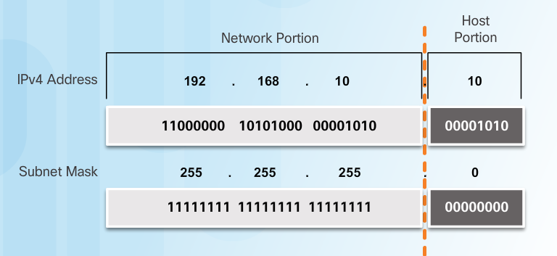
IPv4 Address Structure The Subnet Mask (Cont.)
The IPv4 address is compared to the subnet mask bit by bit, from left to right.
A 1 in the subnet mask indicates that the corresponding bit in the IPv4 address is a network bit.
Notes:
7.1 – IPv4 Network Addresses
7.1.2 – IPv4 Address Structure
7.1.2.2 -The Subnet Mask (Cont.)

Slide 31
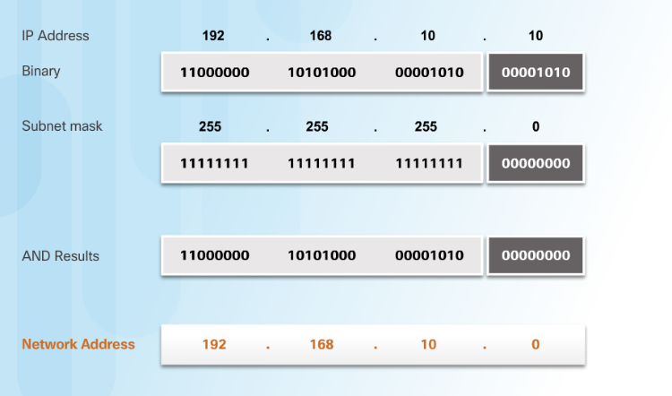
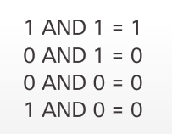
IPv4 Address Structure Logical AND
A logical AND is one of three basic binary operations used in digital logic.
Used to determine the Network Address
The Logical AND of two bits yields the following results:
Notes:
7.1 – IPv4 Network Addresses
7.1.2 – IPv4 Address Structure
7.1.2.3 -Logical AND

Slide 32
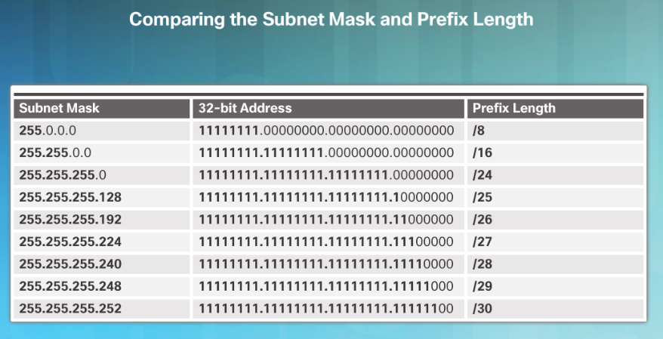
IPv4 Address Structure The Prefix Length
The Prefix Length:
Shorthand method of expressing the subnet mask.
Equals the number of bits in the subnet mask set to 1.
Written in slash notation, / followed by the number of network bits.
Notes:
7.1 – IPv4 Network Addresses
7.1.2 – IPv4 Address Structure
7.1.2.5 - The Prefix Length

Slide 33
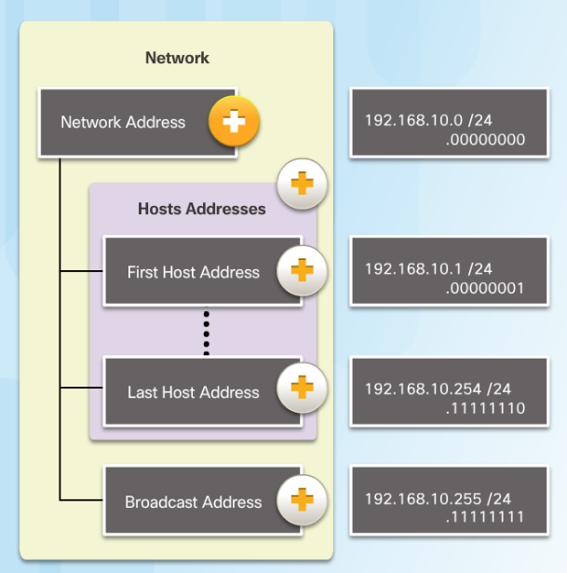
IPv4 Address Structure Network, Host, and Broadcast Addresses
Types of Addresses in Network 192.168.10.0/24
Network Address - host portion is all 0s (.00000000)
First Host address - host portion is all 0s and ends with a 1 (.00000001)
Last Host address - host portion is all 1s and ends with a 0 (.11111110)
Broadcast Address - host portion is all 1s (.11111111)
Notes:
7.1 – IPv4 Network Addresses
7.1.2 – IPv4 Address Structure
7.1.2.6 - Network, Host, and Broadcast Addresses

Slide 34
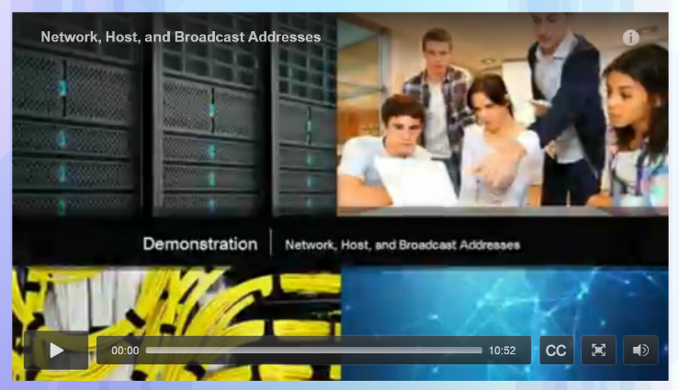
IPv4 Address Structure Video Demonstration - Network, Host, and Broadcast Addresses
This video will cover the process of ANDing as it relates to discovering the network address, the host addresses, and the broadcast address in an IPv4 network.
Notes:
7.1 – IPv4 Network Addresses
7.1.2 – IPv4 Address Structure
7.1.2.7 - Video Demonstration - Network, Host, and Broadcast Addresses

Slide 35
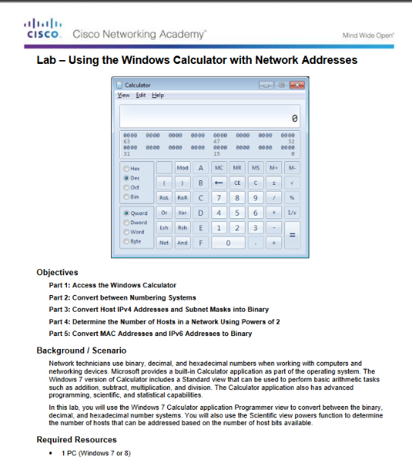
IPv4 Address Structure Lab – Using the Windows Calculator with Network Addresses
Notes:
7.1 – IPv4 Network Addresses
7.1.2 – IPv4 Address Structure
7.1.2.8 - Lab – Using the Windows Calculator with Network Addresses

Slide 36
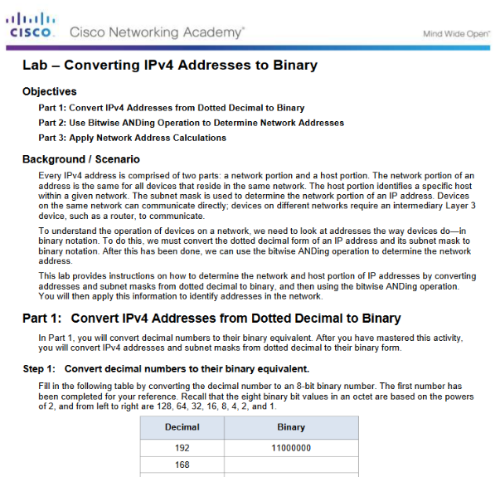
IPv4 Address Structure Lab – Converting IPv4 Addresses to Binary
Notes:
7.1 – IPv4 Network Addresses
7.1.2 – IPv4 Address Structure
7.1.2.9 - Lab – Converting IPv4 Addresses to Binary

Slide 37
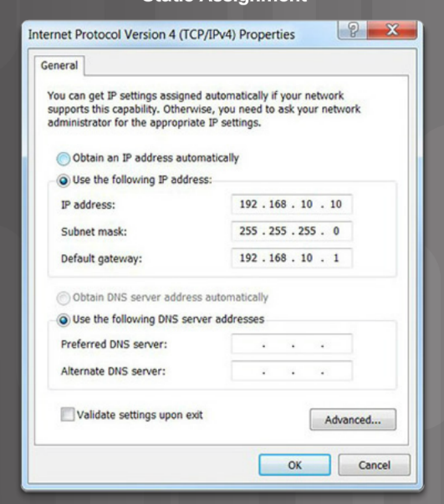
IPv4 Unicast, Broadcast, and Multicast Static IPv4 Address Assignment to a Host
Some devices like printers, servers and network devices require a fixed IP address.
Hosts in a small network can also be configured with static addresses.
Notes:
7.1 – IPv4 Network Addresses
7.1.3 – IPv4 Unicast, Broadcast, and Multicast
7.1.3.1 - Static IPv4 Address Assignment to a Host

Slide 38
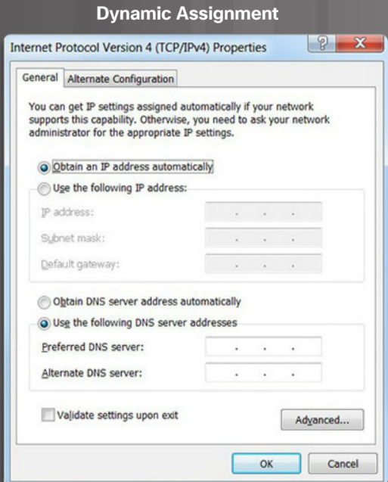
IPv4 Unicast, Broadcast, and Multicast Dynamic IPv4 Address Assignment to a Host
Most networks use Dynamic Host Configuration Protocol (DHCP) to assign IPv4 addresses dynamically.
The DHCP server provides an IPv4 address, subnet mask, default gateway, and other configuration information.
DHCP leases the addresses to hosts for a certain length of time.
If the host is powered down or taken off the network, the address is returned to the pool for reuse.
Notes:
7.1 – IPv4 Network Addresses
7.1.3 – IPv4 Unicast, Broadcast, and Multicast
7.1.3.2 - Dynamic IPv4 Address Assignment to a Host

Slide 39
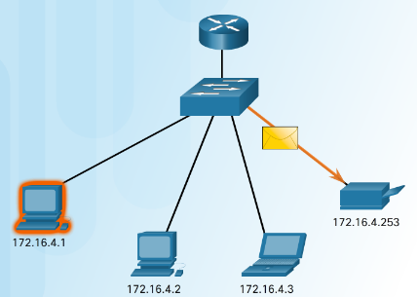
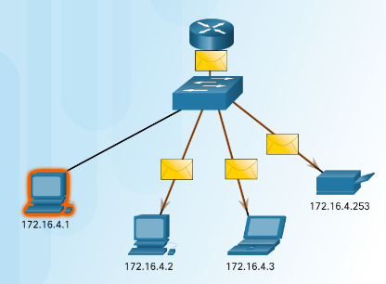
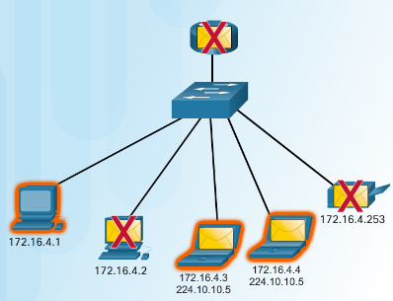
IPv4 Unicast, Broadcast, and Multicast IPv4 Communication
Unicast – one to one communication.
Broadcast– one to all.
Multicast – one to a select group.
Notes:
7.1 – IPv4 Network Addresses
7.1.3 – IPv4 Unicast, Broadcast, and Multicast
7.1.3.3 – IPv4 Communication

Slide 40
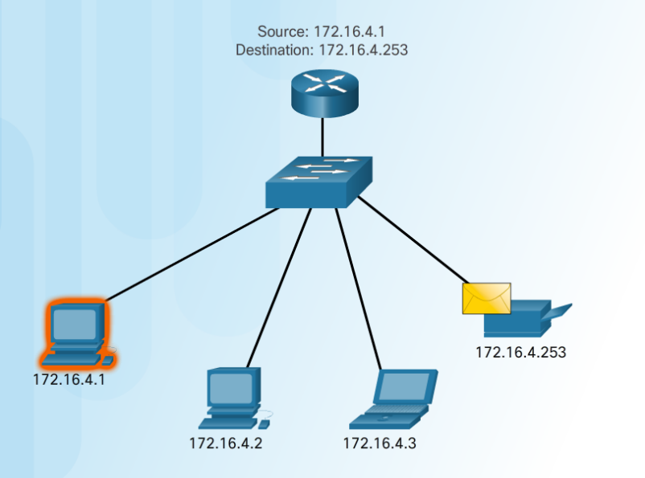
IPv4 Unicast, Broadcast, and Multicast Unicast Transmission
Unicast – one to one communication.
Use the address of the destination device as the destination address.
Notes:
7.1 – IPv4 Network Addresses
7.1.3 – IPv4 Unicast, Broadcast, and Multicast
7.1.3.4 – Unicast Transmission

Slide 41
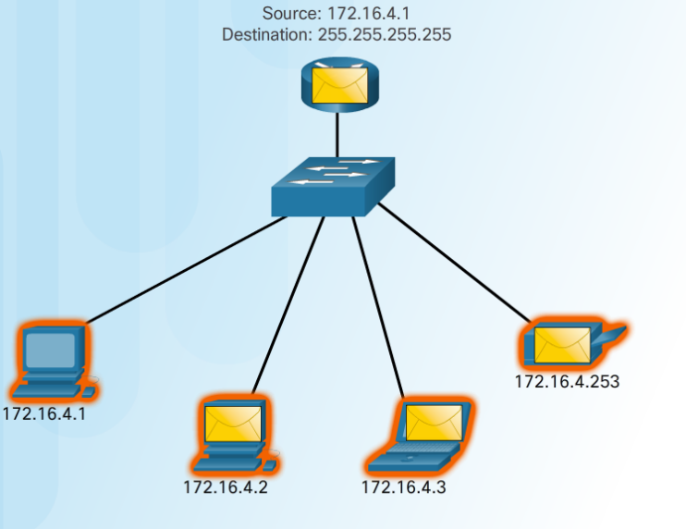
IPv4 Unicast, Broadcast, and Multicast Broadcast Transmission
Broadcast– one to all
Message sent to everyone in the LAN (broadcast domain.)
destination IPv4 address has all ones (1s) in the host portion.
Notes:
7.1 – IPv4 Network Addresses
7.1.3 – IPv4 Unicast, Broadcast, and Multicast
7.1.3.5 – Broadcast Transmission

Slide 42
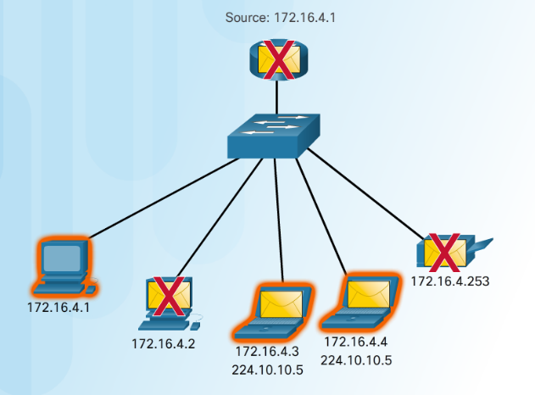
IPv4 Unicast, Broadcast, and Multicast Multicast Transmission
Multicast– one to a select group.
224.0.0.0 to 239.255.255.255 addresses reserved for multicast.
routing protocols use multicast transmission to exchange routing information.
Notes:
7.1 – IPv4 Network Addresses
7.1.3 – IPv4 Unicast, Broadcast, and Multicast
7.1.3.6 – Multicast Transmission

Slide 43
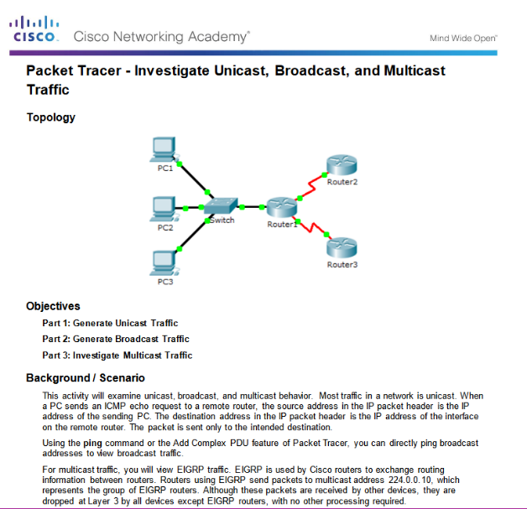
IPv4 Unicast, Broadcast, and Multicast Packet Tracer – Investigate Unicast, Broadcast, and Multicast Traffic
Notes:
7.1 – IPv4 Network Addresses
7.1.3 – IPv4 Unicast, Broadcast, and Multicast
7.1.3.8 – Packet Tracer – Investigate Unicast, Broadcast, and Multicast Traffic

Slide 44
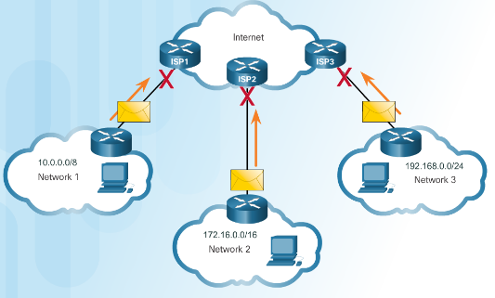
Types of IPv4 Addresses Public and Private IPv4 Addresses
Private Addresses
Not routable
Introduced in mid 1990s due to depletion of IPv4 addresses
Used only in internal networks.
Must be translated to a public IPv4 to be routable.
Defined by RFC 1918
Private Address Blocks
10.0.0.0 /8 or 10.0.0.0 to 10.255.255.255
172.16.0.0 /12 or 172.16.0.0 to 172.31.255.255192.168.0.0 /16
192.168.0.0 to 192.168.255.255
Notes:
7.1 – IPv4 Network Addresses
7.1.4 – Types of IPv4 Addresses
7.1.4.1 – Public and Private IPv4 Addresses

Slide 45
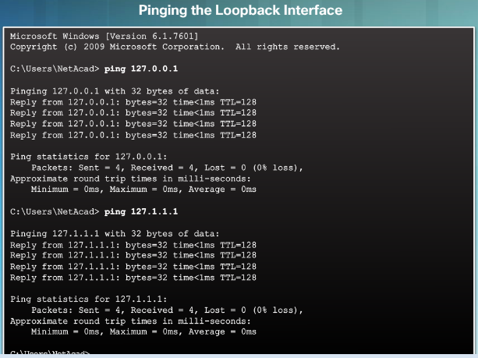
Types of IPv4 Addresses Special User IPv4 Addresses
Loopback addresses (127.0.0.0 /8 or 127.0.0.1)
Used on a host to test if the TCP/IP configuration is operational.
Link-Local addresses (169.254.0.0 /16 or 169.254.0.1)
Commonly known as Automatic Private IP Addressing (APIPA) addresses.
Used by Windows client to self configure if no DHCP server available.
TEST-NET addresses (192.0.2.0/24 or 192.0.2.0 to 192.0.2.255)
Used for teaching and learning.
Notes:
7.1 – IPv4 Network Addresses
7.1.4 – Types of IPv4 Addresses
7.1.4.3 – Special User IPv4 Addresses

Slide 46
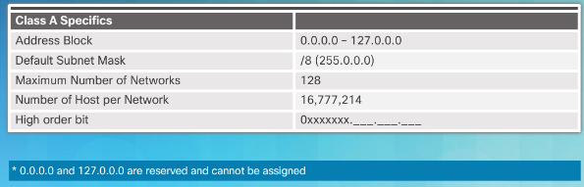
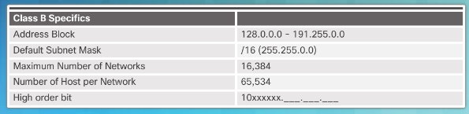
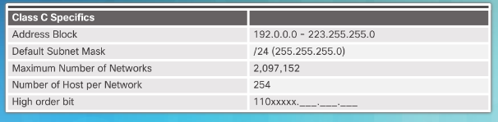
Types of IPv4 Addresses Legacy Classful Addressing
In 1981, Internet IPv4 addresses were assigned using classful addressing (RFC 790)
Network addresses were based on 3 classes:
Class A (0.0.0.0/8 to 127.0.0.0/8) – Designed to support extremely large networks with more than 16 million host addresses.
Class B (128.0.0.0 /16 – 191.255.0.0 /16) – Designed to support the needs of moderate to large size networks up to approximately 65,000 host addresses.
Class C (192.0.0.0 /24 – 223.255.255.0 /24) – Designed to support small networks with a maximum of 254 hosts.
Notes:
7.1 – IPv4 Network Addresses
7.1.4 – Types of IPv4 Addresses
7.1.4.4 – Legacy Classful Addressing

Slide 47
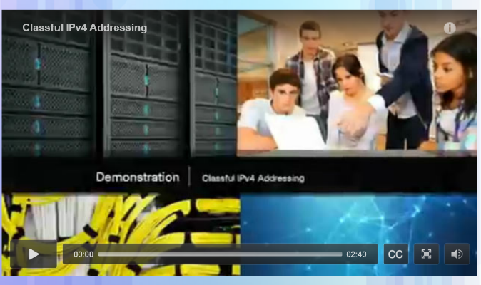
Types of IPv4 Addresses Video Demonstration - Classful IPv4 Addressing
Discussion of Classful Addressing
Identifying a Classful address by the IP address and the subnet mask
Notes:
7.1 – IPv4 Network Addresses
7.1.4 – Types of IPv4 Addresses
7.1.4.5 – Video Demonstration - Classful IPv4 Addressing

Slide 48
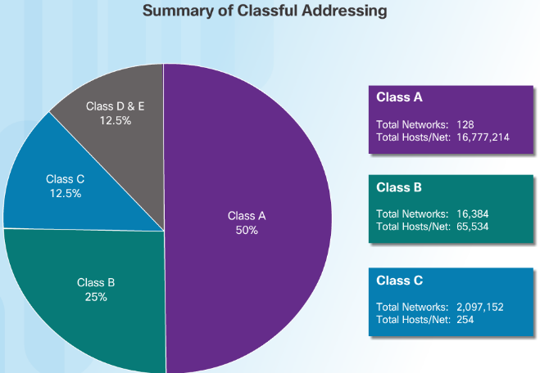
Types of IPv4 Addresses Classless Addressing
Classful Addressing wasted addresses and exhausted the availability of IPv4 addresses.
Classless Addressing Introduced in the 1990s
Classless Inter-Domain Routing (CIDR, pronounced “cider”)
Allowed service providers to allocate IPv4 addresses on any address bit boundary (prefix length) instead of only by a class A, B, or C.
Notes:
7.1 – IPv4 Network Addresses
7.1.4 – Types of IPv4 Addresses
7.1.4.6 – Classless Addressing

Slide 49
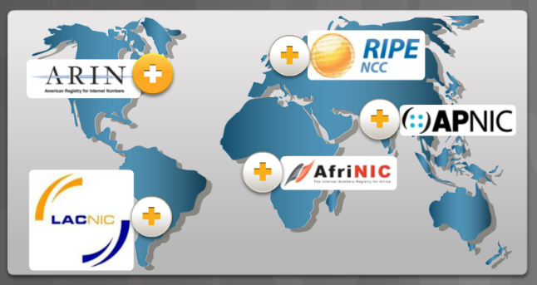
Types of IPv4 Addresses Assignment of IP Addresses
The following organizations manage and maintain IPv4 and IPv6 addresses for the various regions.
American Registry for Internet Numbers (ARIN)- North America.
Réseaux IP Europeans (RIPE) - Europe, the Middle East, and Central Asia
Asia Pacific Network Information Centre (APNIC) - Asia and Pacific regions
African Network Information Centre (AfriNIC) – Africa
Regional Latin-American and Caribbean IP Address Registry (LACNIC) - Latin America and some Caribbean islands
Notes:
7.1 – IPv4 Network Addresses
7.1.4 – Types of IPv4 Addresses
7.1.4.7 – Assignment of IP Addresses

Slide 50
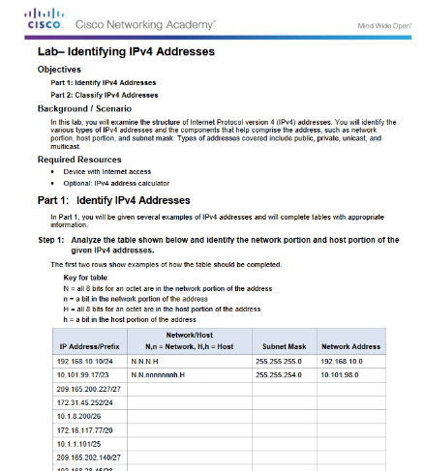
Types of IPv4 Addresses Lab – Identifying IPv4 Addresses
Notes:
7.1 – IPv4 Network Addresses
7.1.4 – Types of IPv4 Addresses
7.1.4.9 – Lab – Identifying IPv4 Addresses

Slide 51
7.2 IPv6 Network Addresses
Notes:
7 – IP Addressing
7.2 – IPv6 Network Addresses

Slide 52
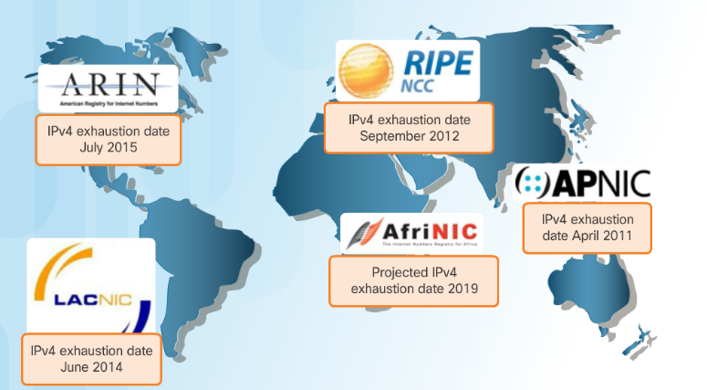
IPv4 Issues The Need for IPv6
IPv6 versus IPv4:
Has a larger 128-bit address space
340 undecillion addresses
Solves limitations with IPv4
Adds enhancement like address auto-configuration.
Why IPv6 is needed:
Rapidly increasing Internet population
Depletion of IPv4
Issues with NAT
Internet of Things
Notes:
7.2 – IPv6 Network Addresses
7.2.1– IPv4 Issues
7.2.1.1 – The Need for IPv6

Slide 53
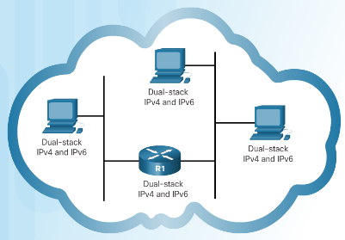
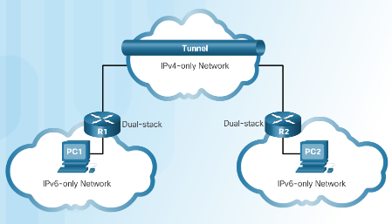
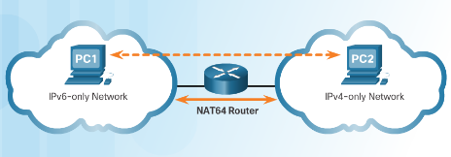
IPv4 Issues IPv4 and IPv6 Coexistence
Migration from IPv4 to IPv6 Techniques
Dual stack - Devices run both IPv4 and IPv6 protocol stacks simultaneously.
Tunneling - The IPv6 packet is encapsulated inside an IPv4 packet.
Translation - Network Address Translation 64 (NAT64) allows IPv6-enabled devices to communicate with IPv4 devices.
Notes:
7.2 – IPv6 Network Addresses
7.2.1– IPv4 Issues
7.2.1.2 – IPv4 and IPv6 Coexistence

Slide 54
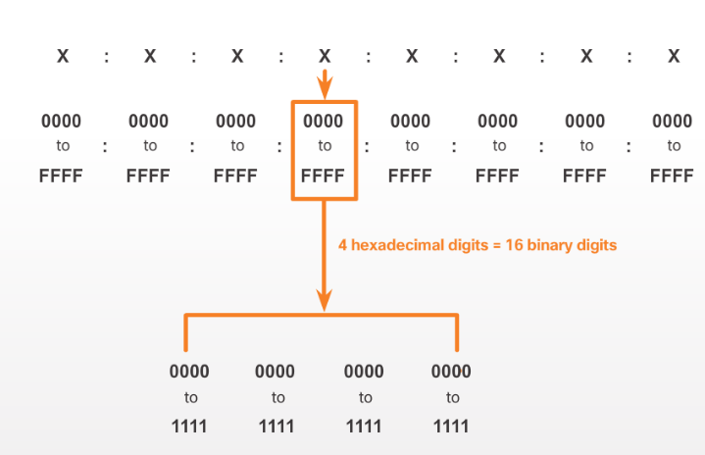
IPv6 Addressing IPv6 Address Representation
IPv6 Addresses:
128 bits in length
Every 4 bits is represented by a single hexadecimal digit
Hextet - unofficial term referring to a segment of 16 bits or four hexadecimal values.
Notes:
7.2 – IPv6 Network Addresses
7.2.2– IPv6 Addressing
7.2.2.1 – IPv6 Address Representation

Slide 55
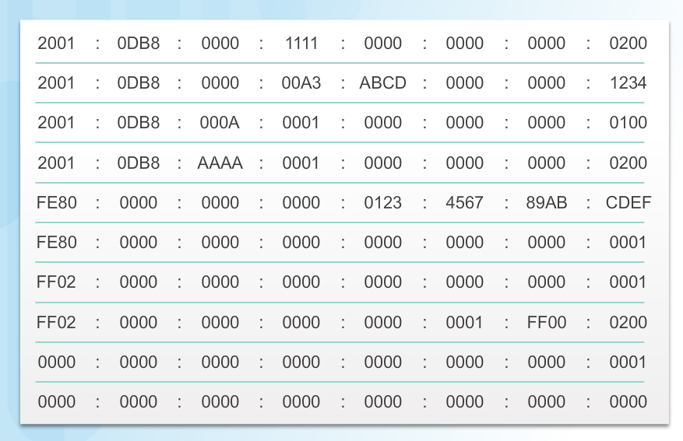
IPv6 Addressing IPv6 Address Representation (Cont.)
Preferred format for IPv6 representation
Notes:
7.2 – IPv6 Network Addresses
7.2.2– IPv6 Addressing
7.2.2.1 – IPv6 Address Representation (Cont.)

Slide 56
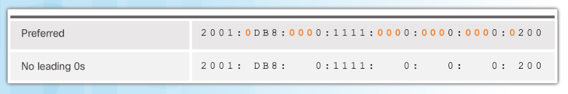
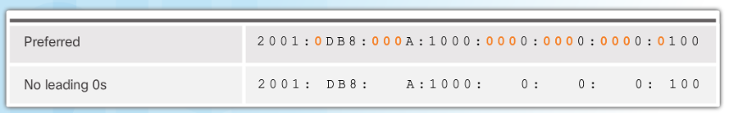

IPv6 Addressing Rule 1 – Omit Leading 0s
In order to reduce or compress IPv6
First rule is to omit leading zeros in any hextet.
Notes:
7.2 – IPv6 Network Addresses
7.2.2– IPv6 Addressing
7.2.2.2 – Rule 1 – Omit Leading 0s

Slide 57

IPv6 Addressing Rule 2 – Omit All 0 Segments
Rule 2 – Omit All 0 Segments
A double colon (::) can replace any single, contiguous string of one or more 16-bit segments (hextets) consisting of all 0s.
Notes:
7.2 – IPv6 Network Addresses
7.2.2– IPv6 Addressing
7.2.2.3 – Rule 2 – Omit All 0 Segments

Slide 58


IPv6 Addressing Rule 2 – Omit All 0 Segments (Cont.)
Rule 2 – Omit All 0 Segments
A double colon (::) can replace any single, contiguous string of one or more 16-bit segments (hextets) consisting of all 0s.
Notes:
7.2 – IPv6 Network Addresses
7.2.2– IPv6 Addressing
7.2.2.3 – Rule 2 – Omit All 0 Segments (Cont.)

Slide 59

Types of IPv6 Addresses IPv6 Address Types
Three types of IPv6 addresses:
Unicast- Single source IPv6 address.
Multicast - An IPv6 multicast address is used to send a single IPv6 packet to multiple destinations.
Anycast - An IPv6 anycast address is any IPv6 unicast address that can be assigned to multiple devices.
Notes:
7.2 – IPv6 Network Addresses
7.2.3 – Types of IPv6 Addresses
7.2.3.1 – IPv6 Address Types

Slide 60

Types of IPv6 Addresses IPv6 Prefix Length
The IPv6 prefix length is used to indicate the network portion of an IPv6 address:
The prefix length can range from 0 to 128.
Typical IPv6 prefix length for most LANs is /64
Notes:
7.2 – IPv6 Network Addresses
7.2.3 – Types of IPv6 Addresses
7.2.3.2 – IPv6 Prefix Length

Slide 61

Types of IPv6 Addresses IPv6 Unicast Addresses
Global Unicast - These are globally unique, Internet routable addresses.
Link-local - used to communicate with other devices on the same local link. Confined to a single link.
Unique Local - used for local addressing within a site or between a limited number of sites.
Notes:
7.2 – IPv6 Network Addresses
7.2.3 – Types of IPv6 Addresses
7.2.3.3 – IPv6 Unicast Addresses

Slide 62

Types of IPv6 Addresses IPv6 Link-Local Unicast Addresses
IPv6 link-local addresses:
Enable a device to communicate with other IPv6-enabled devices on the same link only.
Are created even if the device has not been assigned a global unicast IPv6 address.
Are in the FE80::/10 range.
Note: Typically, it is the link-local address of the router that is used as the default gateway for other devices on the link.
Notes:
7.2 – IPv6 Network Addresses
7.2.3 – Types of IPv6 Addresses
7.2.3.4 – IPv6 Link-Local Unicast Addresses

Slide 63


IPv6 Unicast Addresses Structure of an IPv6 Global Unicast Address
Currently, only global unicast addresses with the first three bits of 001 or 2000::/3 are being assigned
A global unicast address has three parts:
Global routing prefix - network, portion of the address that is assigned by the provider. Typically /48.
Subnet ID – Used to subnet within an organization.
Interface ID - equivalent to the host portion of an IPv4 address.
Notes:
7.2 – IPv6 Network Addresses
7.2.4 – IPv6 Unicast Addresses
7.2.4.1 – Structure of an IPv6 Global Unicast Address

Slide 64

IPv6 Unicast Addresses Static Configuration of a Global Unicast Address
Router Configuration:
Similar commands to IPv4, replace IPv4 with IPv6
Command to configure andIPv6 global unicast on an interface is ipv6 address ipv6-address/prefix-length
Notes:
7.2 – IPv6 Network Addresses
7.2.4 – IPv6 Unicast Addresses
7.2.4.2 - Static Configuration of a Global Unicast Address

Slide 65

IPv6 Unicast Addresses Static Configuration of a Global Unicast Address (Cont.)
Host Configuration:
Manually configuring the IPv6 address on a host is similar to configuring an IPv4 address
Default gateway address can be configured to match the link-local or global unicast address of the Gigabit Ethernet interface.
Dynamic assignment of IPv6 addresses:
Stateless Address Autoconfiguration (SLAAC)
Stateful DHCPv6
Notes:
7.2 – IPv6 Network Addresses
7.2.4 – IPv6 Unicast Addresses
7.2.4.2 - Static Configuration of a Global Unicast Address (Cont.)

Slide 66

IPv6 Unicast Addresses Dynamic Configuration - SLAAC
Stateless Address Autoconfiguration (SLAAC):
A device can obtain its prefix, prefix length, default gateway address, and other information from an IPv6 router.
Uses the local router’s ICMPv6 Router Advertisement (RA) messages
ICMPv6 RA messages sent every 200 seconds to all IPv6-enabled devices on the network.
Option 1 (SLAAC Only) – "I'm everything you need (Prefix, Prefix-length, Default Gateway)"
Option 2 (SLAAC and DHCPv6) – "Here is my information but you need to get other information such as DNS addresses from a DHCPv6 server."
Option 3 (DHCPv6 Only) – "I can’t help you. Ask a DHCPv6 server for all your information."
Notes:
7.2 – IPv6 Network Addresses
7.2.4 – IPv6 Unicast Addresses
7.2.4.3 - Dynamic Configuration - SLAAC

Slide 67

IPv6 Unicast Addresses Dynamic Configuration – DHCPv6
The RA Option 1: SLAAC only (this is the default)
RA Option 2: SLAAC and Stateless DHCPv6:
Uses SLAAC for IPv6 global unicast address and default gateway.
Uses a stateless DHCPv6 server for other information.
RA Option 3: Stateful DHCPv6
Uses the Routers link-local address for the default gateway.
Uses DHCPv6 for all other information.
Notes:
7.2 – IPv6 Network Addresses
7.2.4 – IPv6 Unicast Addresses
7.2.4.4 - Dynamic Configuration – DHCPv6

Slide 68

IPv6 Unicast Addresses EUI-64 Process and Randomly Generated
When the RA message is SLAAC or SLAAC with stateless DHCPv6, the client must generate its own Interface ID
The Interface ID can be created using the EUI-64 process or a randomly generated 64-bit number
An EUI-64 Interface ID is represented in binary and is made up of three parts:
24-bit OUI from the client MAC address, but the 7th bit (the Universally/Locally (U/L) bit) is reversed.
The inserted 16-bit value FFFE (in hexadecimal).
24-bit Device Identifier from the client MAC address.
Notes:
7.2 – IPv6 Network Addresses
7.2.4 – IPv6 Unicast Addresses
7.2.4.5 - EUI-64 Process and Randomly Generated

Slide 69

IPv6 Unicast Addresses EUI-64 Process and Randomly Generated (Cont.)
Randomly Generated Interface IDs
Windows uses a randomly generated Interface ID
Notes:
7.2 – IPv6 Network Addresses
7.2.4 – IPv6 Unicast Addresses
7.2.4.5 - EUI-64 Process and Randomly Generated (Cont.)

Slide 70

IPv6 Unicast Addresses Dynamic Link-Local Addresses
Link-local address can be established dynamically or configured manually.
Cisco IOS routers use EUI-64 to generate the Interface ID for all link-local address on IPv6 interfaces.
Drawback to using the dynamically assigned link-local address is the long interface ID, therefore they are often configured statically.
Notes:
7.2 – IPv6 Network Addresses
7.2.4 – IPv6 Unicast Addresses
7.2.4.6 - Dynamic Link-Local Addresses

Slide 71

IPv6 Unicast Addresses Static Link-Local Addresses
Manual Configuration of the link-local address allows the creation of a simple, easy to remember address.
Notes:
7.2 – IPv6 Network Addresses
7.2.4 – IPv6 Unicast Addresses
7.2.4.7 - Static Link-Local Addresses

Slide 72



IPv6 Unicast Addresses Verifying IPv6 Address Configuration
The commands to verify IPv6 configuration are similar to IPv4
show ipv6 interface brief
show ipv6 route
The ping command for IPv6 is identical to the command used with IPv4, except that an IPv6 address is used.
Notes:
7.2 – IPv6 Network Addresses
7.2.4 – IPv6 Unicast Addresses
7.2.4.8 - Verifying IPv6 Address Configuration

Slide 73

IPv6 Unicast Addresses Packet Tracer – Configuring IPv6 Addressing
Notes:
7.2 – IPv6 Network Addresses
7.2.4 – IPv6 Unicast Addresses
7.2.4.9 - Packet Tracer – Configuring IPv6 Addressing

Slide 74

IPv6 Multicast Addresses Assigned IPv6 Multicast Addresses
There are two types of IPv6 multicast addresses:
Assigned multicast - reserved multicast addresses for predefined groups of devices
Solicited node multicast
Two common IPv6 assigned multicast groups:
FF02::1 All-nodes multicast group – This is a multicast group that all IPv6-enabled devices join. Similar to a broadcast in IPv4
FF02::2 All-routers multicast group – This is a multicast group that all IPv6 routers join.
Notes:
7.2 – IPv6 Network Addresses
7.2.5 – IPv6 Multicast Addresses
7.2.5.1 - Assigned IPv6 Multicast Addresses

Slide 75

IPv6 Multicast Addresses Solicited-Node IPv6 Multicast Addresses
Solicited-node multicast address:
Mapped to .a special Ethernet multicast address
Allows Ethernet NIC to filter frame on destination MAC.
Notes:
7.2 – IPv6 Network Addresses
7.2.5 – IPv6 Multicast Addresses
7.2.5.2 - Solicited-Node IPv6 Multicast Addresses

Slide 76

IPv6 Multicast Addresses Lab – Identifying IPv6 Addresses
Notes:
7.2 – IPv6 Network Addresses
7.2.5 – IPv6 Multicast Addresses
7.2.5.3 - Lab – Identifying IPv6 Addresses

Slide 77

IPv6 Multicast Addresses Lab – Configuring IPv6 Addresses on Network Devices
Notes:
7.2 – IPv6 Network Addresses
7.2.5 – IPv6 Multicast Addresses
7.2.5.4- Lab – Configuring IPv6 Addresses on Network Devices

Slide 78
7.3 Connectivity Verification
Notes:
7 – IP Addressing
7.3– Connectivity Verification

Slide 79

ICMP ICMPv4 and ICMPv6
ICMPv4 is the messaging protocol for IPv4. ICMPv6 provides the same services for IPv6
ICMP messages common to both include:
Host confirmation
Destination or Service Unreachable
Time exceeded
Route redirection
Notes:
7.3 – Connectivity Verification
7.3.1 – ICMP
7.3.1.1 - ICMPv4 and ICMPv6

Slide 80


ICMP ICMPv6 Router Solicitation and Router Advertisement Messages
ICMPv6 includes four new protocols as part of the Neighbor Discovery Protocol (ND or NDP)
Router Solicitation (RS) message
Router Advertisement (RA) message
RA messages used to provide addressing information to hosts
Neighbor Solicitation (NS) message
Neighbor Advertisement (NA) message
Neighbor Solicitation and Neighbor Advertisement messages are used for Address resolution and Duplicate Address Detection (DAD).
Notes:
7.3 – Connectivity Verification
7.3.1 – ICMP
7.3.1.2 - ICMPv6 Router Solicitation and Router Advertisement Messages

Slide 81

Testing and Verification Ping - Testing the Local Stack
Ping the local loopback address of 127.0.0.1 for IPv4 or ::1 for IPv6 to verify that IP is properly installed on the host.
Notes:
7.3 – Connectivity Verification
7.3.2 – Testing and Verification
7.3.2.1 - Ping - Testing the Local Stack

Slide 82

Testing and Verification Ping – Testing Connectivity to the Local LAN
Use ping to test the ability of a host to communicate on the local network.
Notes:
7.3 – Connectivity Verification
7.3.2 – Testing and Verification
7.3.2.2 - Ping – Testing Connectivity to the Local LAN

Slide 83

Testing and Verification Ping – Testing Connectivity to a Remote Host
Use ping to test the ability of a host to communicate across an internetwork.
Notes:
7.3 – Connectivity Verification
7.3.2 – Testing and Verification
7.3.2.3 - Ping – Testing Connectivity to a Remote Host

Slide 84

Testing and Verification Traceroute – Testing the Path
Traceroute (tracert) is a utility that generates a list of hops that were successfully reached along the path.
Round Trip Time (RTT) – Time it takes the packet to reach the remote host and for the response from the host to return.
Asterisk (*) is used to indicate a lost packet.
Notes:
7.3 – Connectivity Verification
7.3.2 – Testing and Verification
7.3.2.4 - Traceroute – Testing the Path

Slide 85

Testing and Verification Packet Tracer – Verifying IPv4 and IPv6 Addressing
Notes:
7.3 – Connectivity Verification
7.3.2 – Testing and Verification
7.3.2.5 - Packet Tracer – Verifying IPv4 and IPv6 Addressing

Slide 86

Testing and Verification Packet Tracer – Pinging and Tracing to Test the Path
Notes:
7.3 – Connectivity Verification
7.3.2 – Testing and Verification
7.3.2.6 - Packet Tracer – Pinging and Tracing to Test the Path

Slide 87
Testing and Verification Lab – Testing Network Connectivity with Ping and Traceroute
Notes:
7.3 – Connectivity Verification
7.3.2 – Testing and Verification
7.3.2.7 - Lab – Testing Network Connectivity with Ping and Traceroute

Slide 88

Testing and Verification Lab – Mapping the Internet
Notes:
7.3 – Connectivity Verification
7.3.2 – Testing and Verification
7.3.2.8 - Lab – Mapping the Internet

Slide 89

Testing and Verification Packet Tracer – Troubleshooting IPv4 and IPv6 Addressing
Notes:
7.3 – Connectivity Verification
7.3.2 – Testing and Verification
7.3.2.9 - Packet Tracer – Troubleshooting IPv4 and IPv6 Addressing

Slide 90
7.4 Chapter Summary
Notes:
7 – IP Addressing
7.4 – Summary

Slide 91

Conclusion Packet Tracer – Skills Integration Challenge
Notes:
7.4 – Summary
7.4.1 – Conclusion
7.4.1.2 - Packet Tracer – Skills Integration Challenge

Slide 92
Conclusion Chapter 7: IP Addressing
Explain the use of IPv4 addresses to provide connectivity in small to medium-sized business networks
Configure IPv6 addresses to provide connectivity in small to medium-sized business networks.
Use common testing utilities to verify and test network connectivity.
Notes:
7.4 – Summary
7.4.1 – Conclusion
7.4.1.3 – Chapter 7: IP Addressing

Slide 94
Chapter 7 New Terms and Commands
octets
logical AND
prefix length
slash notation
network address
host address
broadcast address
directed broadcast
limited broadcast
multicast group
Public IPv4
private IPv4 addresses
link-local address (IPv4)
TEST-NET addresses
classful addressing
Classless
Internet Assigned Numbers Authority (IANA)
Regional Internet Registries (RIRs)
dual stack
tunneling
Network Address Translation 64 (NAT64)
preferred global unicast address (GUA)
link-local (IPv6)
unique local
global routing prefix
subnet ID
interface ID
stateless DHCPv6
stateful DHCPv6
Extended Unique Identifier (EUI-64)
assigned multicast
solicited-node multicast address
router solicitation (RS) message
router advertisement (RA)
message neighbor solicitation (NS)
neighbor advertisement (NA)

